Slide 2
Why machine learning

Slide 3
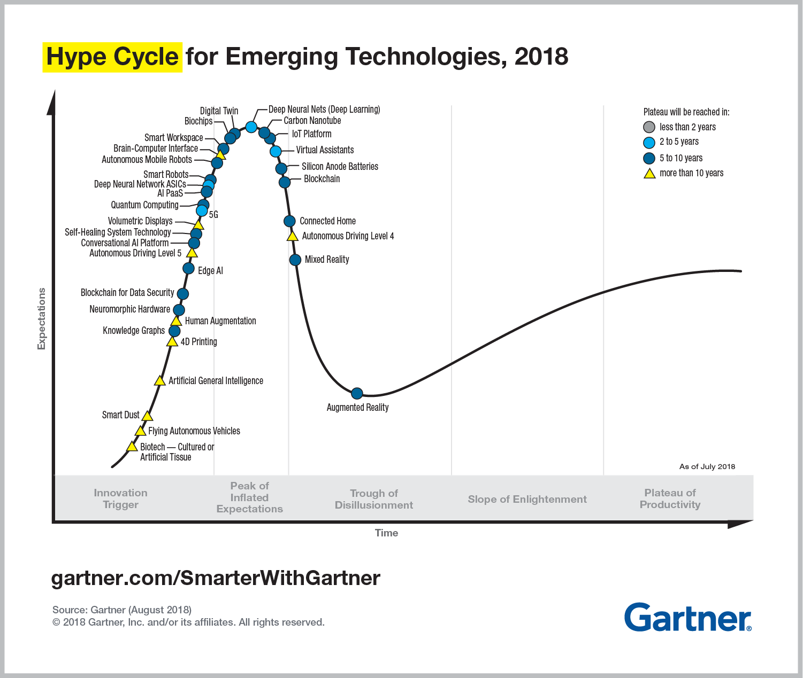
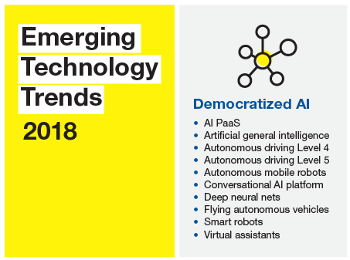
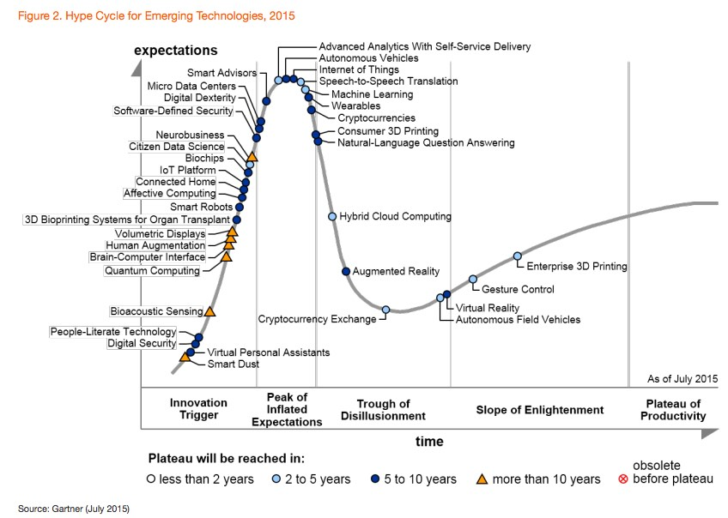
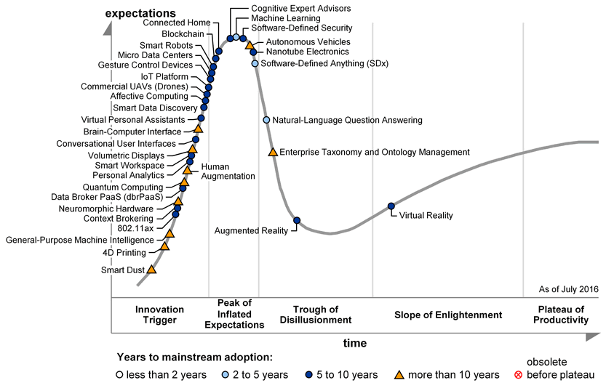
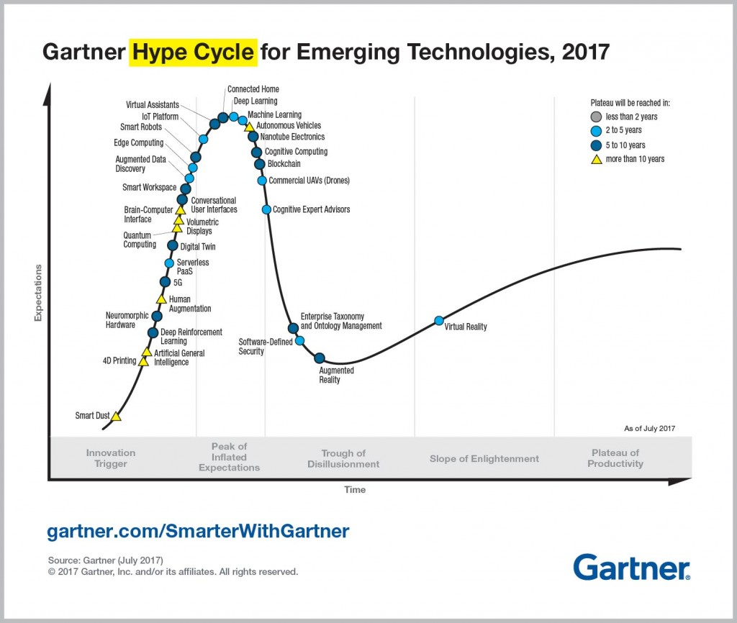

Slide 4
Intro

Slide 5
Artificial intelligence
Any technique that enables computer to mimic human behavior
Machine Learning
Ability to learn without being explicitly programmed
Deep learning
Learning underlying features in data using neural networks
Notes:
Artificial intelligence – playing chess in 90s. Face recognition by eye position
Machine learning – recommendation engine in 00s (Netflix)?
Deep learning – complex algorithm like

Slide 6
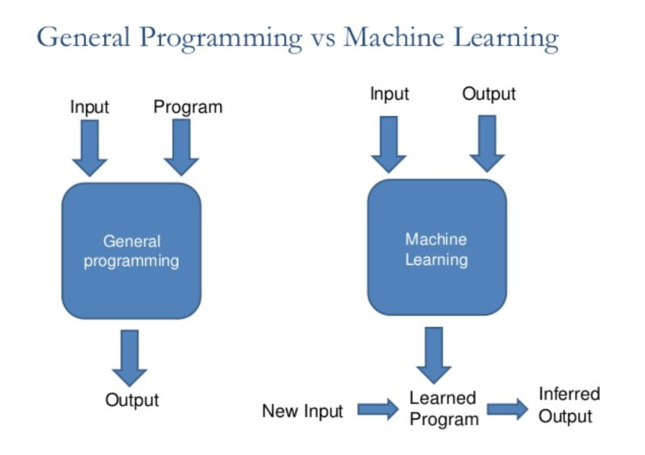

Slide 7
Machine Learning
Deep learning
More complex
Classic problems
Statistics
Algorithms
MACHINE LEARNING

Slide 8
To use or not to use
To use
You have a lot of data
Your task is repetitive
Not to use
Your task is innovative or creative
Your data set is small (features/size)
If algorithmic solution exists
To solve „world hunger problem”
To become a billionaire
If you don’t have money

Slide 9
The process

Slide 10
Question
Train (Machine Learning)
Use in production
Get data

Slide 11
Data acquisition
Data cleaning
Feature engineering
Building model (coding)
Training
model
Model evaluation
Production usage

Slide 12
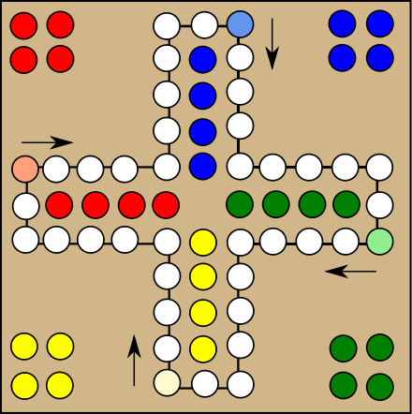
Notes:
"Mensch ärgere Dich nicht" / Ludo / Chińczyk

Slide 13
Data aquisition
Data cleaning
Feature engineering
Building model (coding)
Training
model
Model evaluation
Production usage

Slide 14
Data Acquisition
Business data
Logs
Device historical data
Process of getting access to it
Completeness of data
Volume of data
Various data sources
Domain & business understanding

Slide 15
Data cleaning
process of detecting and correcting (or removing) corrupt or inaccurate records from a record set,
Data aquisition
Data cleaning
Feature engineering
Building model (coding)
Training
model
Model evaluation
Production usage

Slide 16
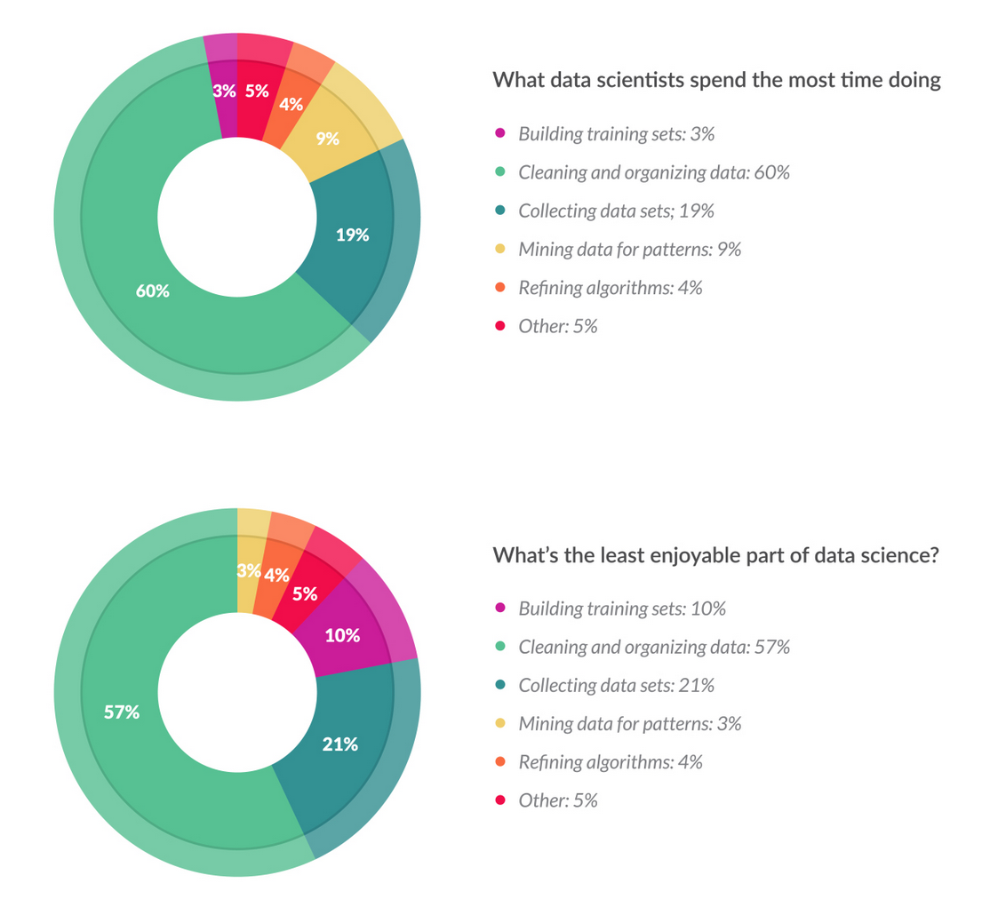
Data Cleaning
Data transformation
Empty values
Invalid values (e.g. Longitude > 90)
Unrealistic values (e.g. Longitude = 0)
Misformatted (e.g. „,Leil. Nr. 20 Bakkalykkja 1A”)
Merging data from different sources
Lack of foreign keys
Different time periods
Different filters applied
https://visit.figure-eight.com/rs/416-ZBE-142/images/CrowdFlower_DataScienceReport_2016.pdf
Notes:
Similar as for data warehouse

Slide 17
Feature engineering
Using domain knowledge of the data to create features that make machine learning algorithms work.
Feature engineering is fundamental to the application of machine learning, and is both difficult and expensive
Data aquisition
Data cleaning
Feature engineering
Building model (coding)
Training
model
Model evaluation
Production usage

Slide 18
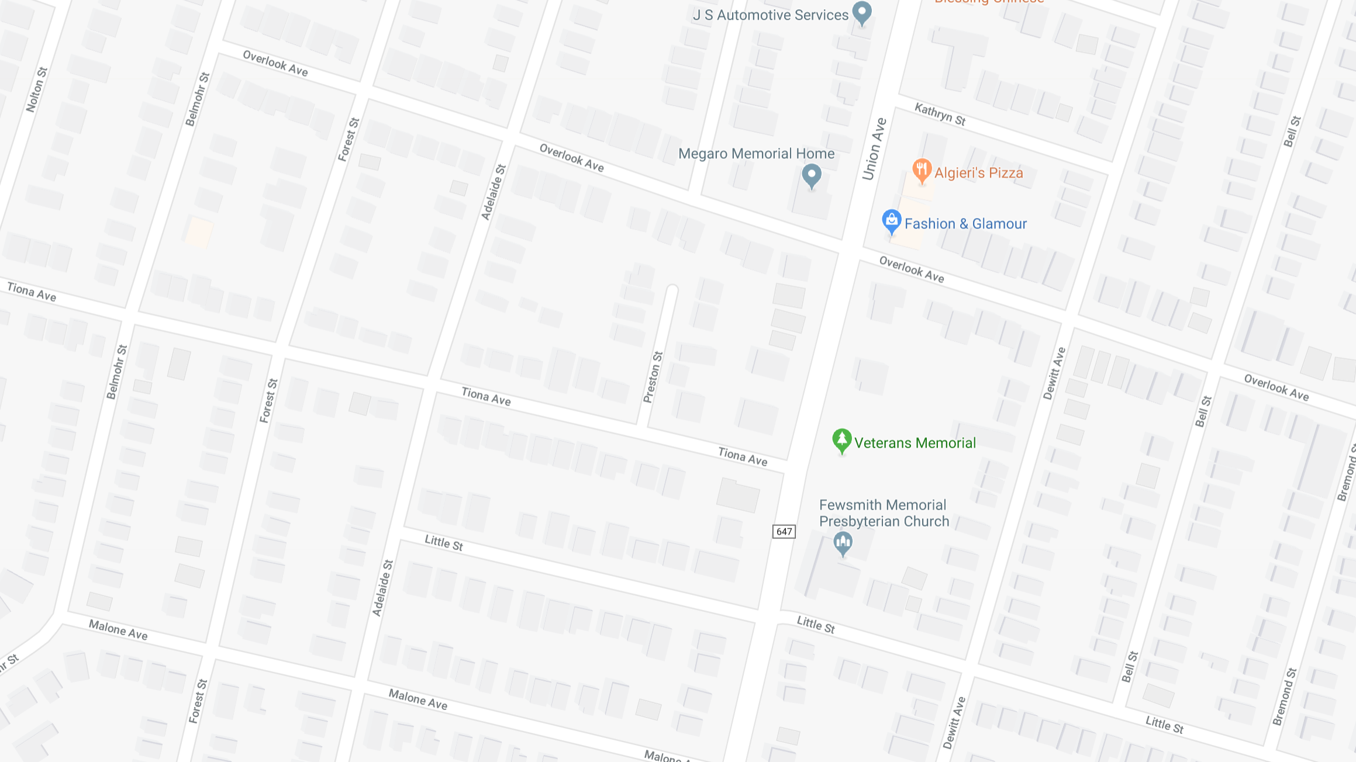
$442
$541
$540
$ 27360
$540
$460

Slide 19
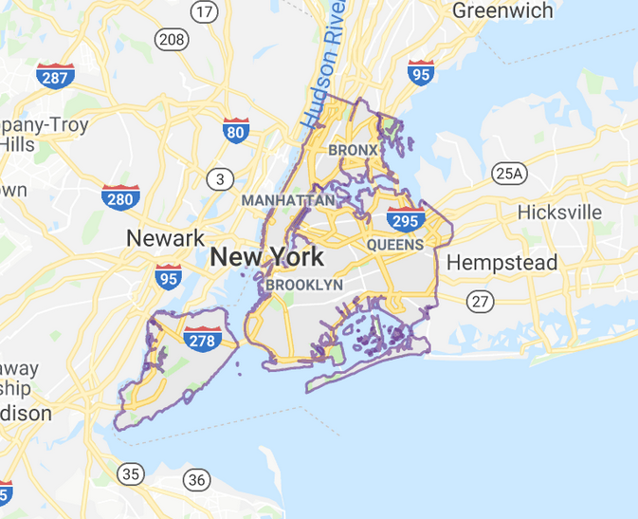
FEATURE Engineering
Features
Labels
City | Street | Value ($)
New York | N Heldon Ave 213 | 315
New York | Mountain Ave 153 | 412
River dale | Sunset Rd 13 | 128
Boonton | Vali Rd 12 | 178
… | ..
City | Street | Value ($)
New York | Belvedere Ave 153 | ?

Slide 20
FEATURE Engineering
Real estate value estimation
City | Street | Latitude | Longitude | Value ($)
New York | N Heldon Ave 213 | 40.123 | -74.234 | 315
New York | Mountain Ave 153 | 40.454 | -74.352 | 412
River dale | Sunset Rd 13 | 41.043 | -73.123 | 128
Boonton | Vali Rd 12 | 41.345 | -75.454 | 178
… | ..
City | Street | Latitude | Longitude | Value ($)
New York | Belvedere Ave 153 | 41.223 | -74.154 | ?

Slide 21
FEATURE Engineering
Real estate value estimation
City | Street | Latitude | Longitude | To center | Value ($)
New York | N Heldon Ave 213 | 40.123 | -74.234 | 1.3 | 315
New York | Mountain Ave 153 | 40.454 | -74.352 | 0.7 | 412
River dale | Sunset Rd 13 | 41.043 | -73.123 | 4.9 | 128
Boonton | Vali Rd 12 | 41.345 | -75.454 | 5.2 | 178
… | ..
City | Street | Latitude | Longitude | To center | Value ($)
New York | N Heldon Ave 213 | 40.123 | -74.234 | 1.3 | ?

Slide 22
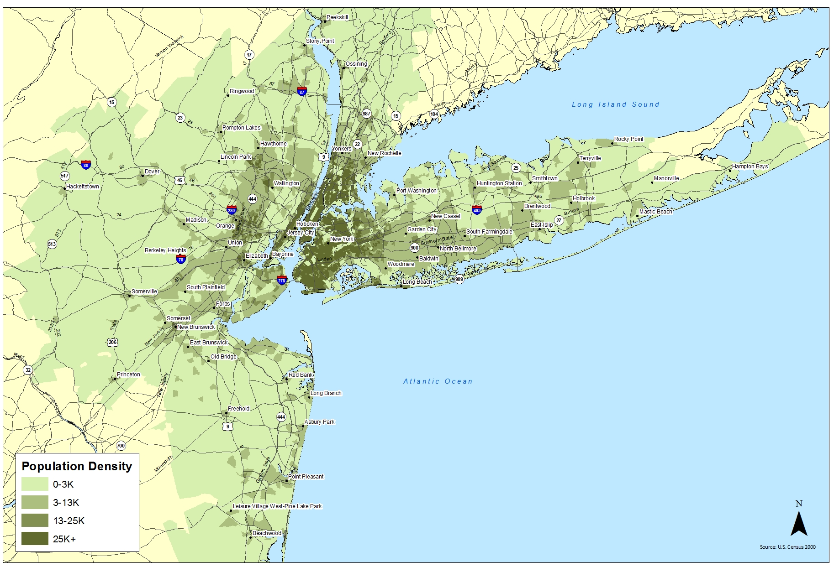
FEATURE Engineering
City | Street | Lat. | Long. | Center | Density | Value ($)
New York | N Heldon Ave 213 | 40.123 | -74.234 | 1.3 | 14 | 315
New York | Mountain Ave 153 | 40.454 | -74.352 | 0.7 | 27 | 412
River dale | Sunset Rd 13 | 41.043 | -73.123 | 4.9 | 22 | 128
Boonton | Vali Rd 12 | 41.345 | -75.454 | 5.2 | 44 | 178
.. | .. | .. | .. | .. | .. | ..

Slide 23
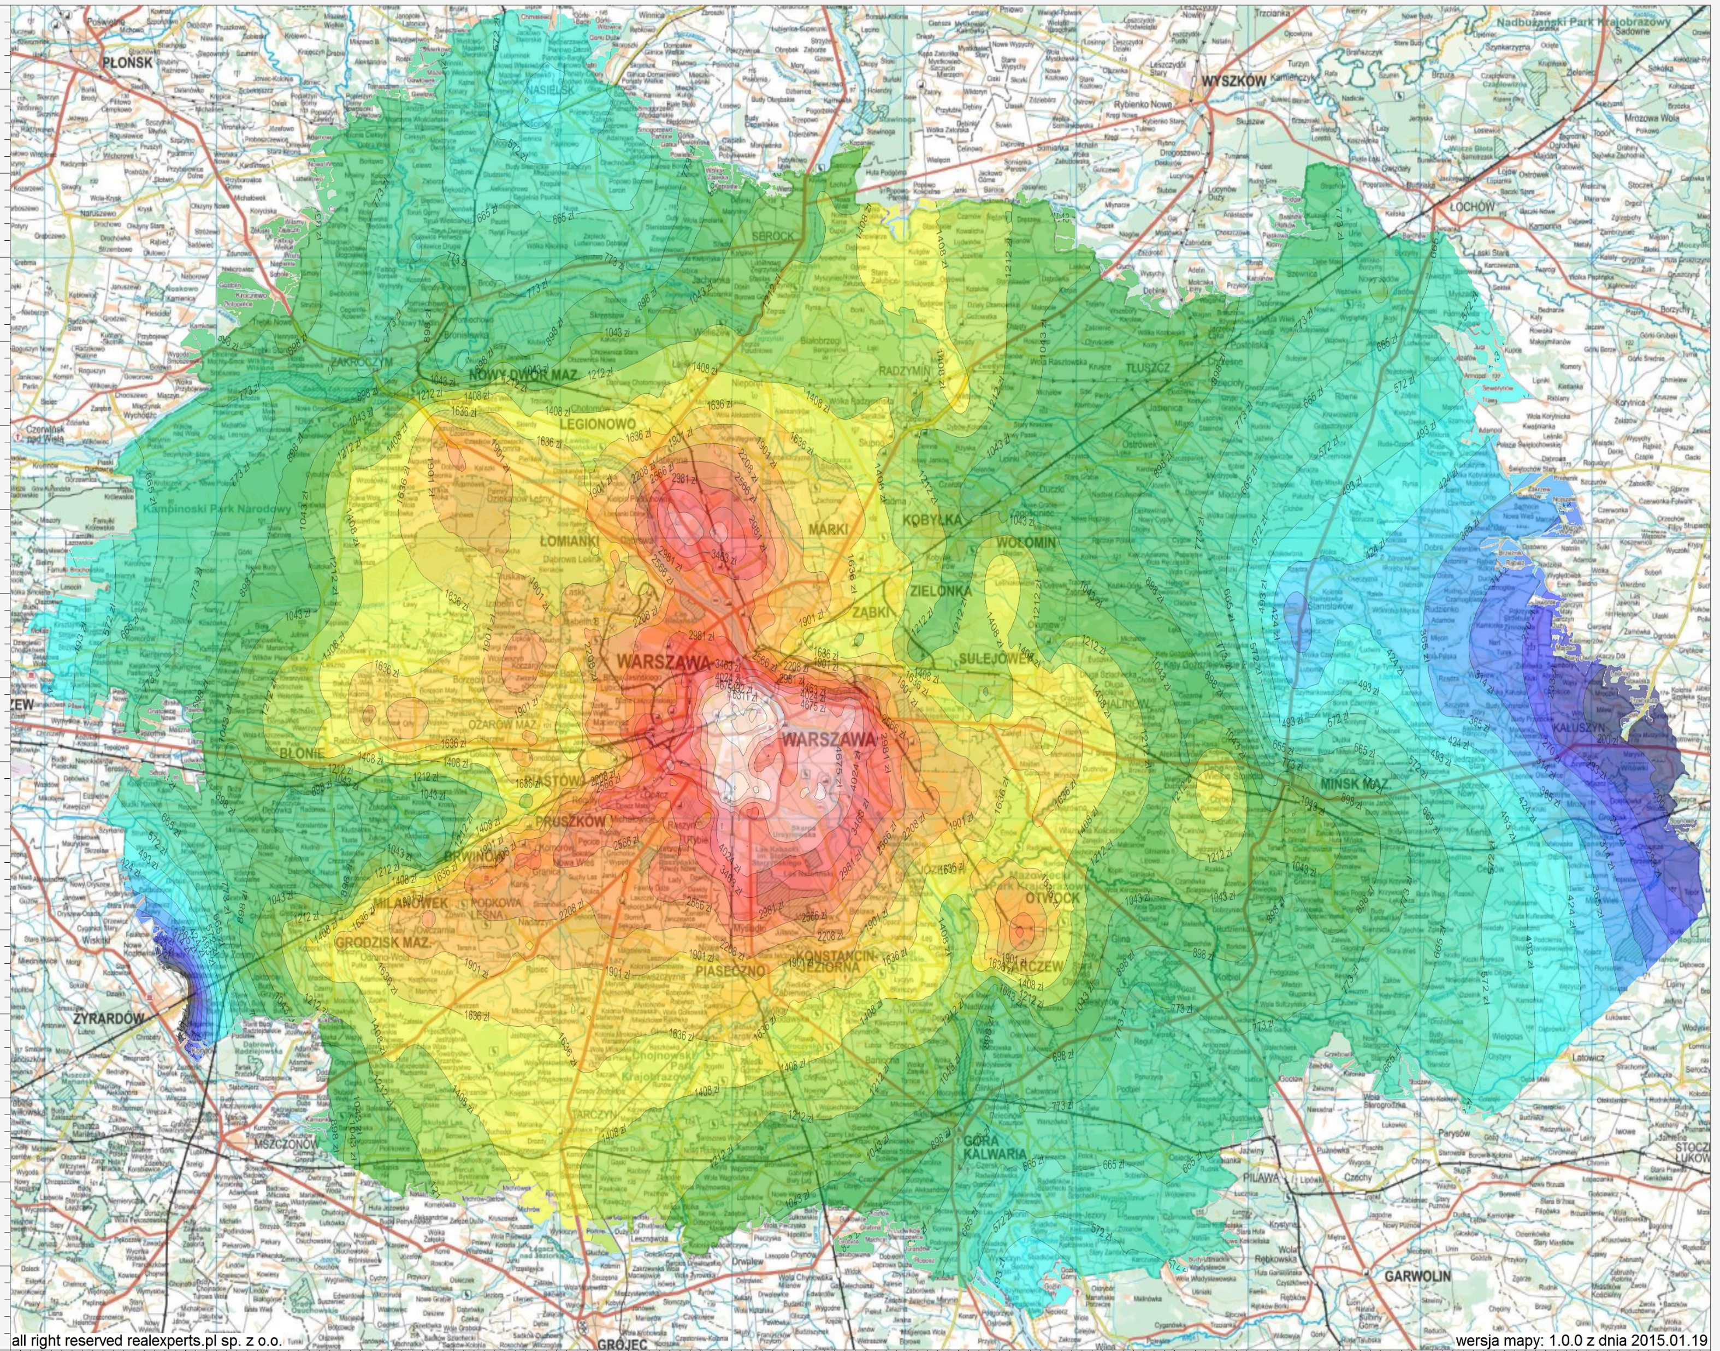
FEATURE Engineering

Slide 24
Building a model
Choosing and configuring right algorithm
Data aquisition
Data cleaning
Feature engineering
Building model (coding)
Training
model
Model evaluation
Production usage

Slide 25
Building a Model
Has wife?
Children <1
Children >=1
Income >$100k
…
…
YES
NO
YES
NO
Income <$100k
…
…
City | Income | Spouse | Children | Loan value | Decision
John | $95k | Yes | 2 | $250 | Yes
Peter | $140k | No | 0 | $210k | Yes
Sam | $32k | Yes | 1 | $20k | No
Anna | $110k | No | 1 | $750k | YES
.. | .. | .. | .. | .. | ..
City | Income | Spouse | Children | Loan value | Decision
Kate | $150k | Yes | 1 | $650 | ?

Slide 26
Building A mOdel
Select algorithm
„Decision trees”
Configure it (set parameters)
Depth
Number of leafs
Split points
Number of phases
…
Labeled data
Algorithm name
Parameters
CPU power
Trained model
City | Income | Spouse | Children | Loan value
Kate | $150k | Yes | 1 | $650
Decision
Yes

Slide 27
Evaluating model
How well it’s trained
Data aquisition
Data cleaning
Feature engineering
Building model (coding)
Training
model
Model evaluation
Production usage

Slide 28
Builing a Model
Training set
City | Income | Spouse | Children | Loan value | Decision
John | $95k | Yes | 2 | $250 | Yes
Peter | $140k | No | 0 | $210k | Yes
Sam | $32k | Yes | 1 | $20k | No
City | Income | Spouse | Children | Loan value | Decision
John | $95k | Yes | 2 | $250 | Yes
Peter | $140k | No | 0 | $210k | Yes
Sam | $32k | Yes | 1 | $20k | No
Anna | $110k | No | 1 | $750k | YES
.. | .. | .. | .. | .. | ..
City | Income | Spouse | Children | Loan value | Decision
Anna | $110k | No | 1 | $750k | YES
.. | .. | .. | .. | .. | ..
City | Income | Spouse | Children | Loan value | Decision
Kate | $150k | Yes | 1 | $650 | ?
Test set

Slide 29
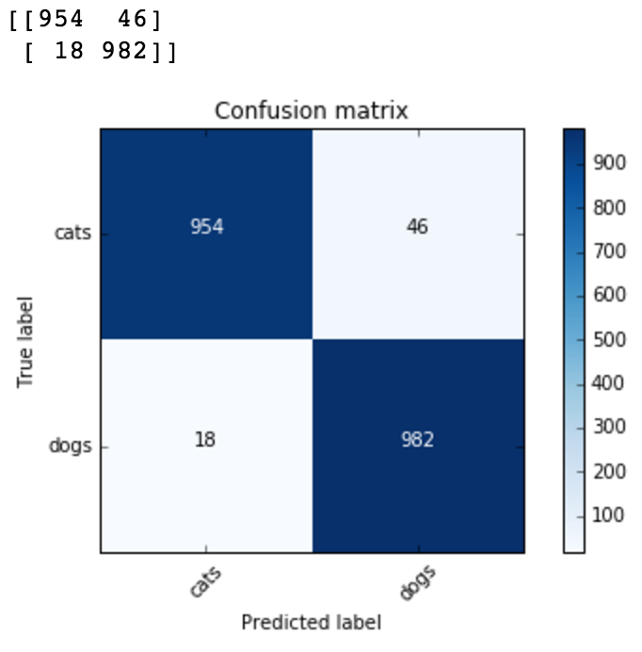

Slide 30
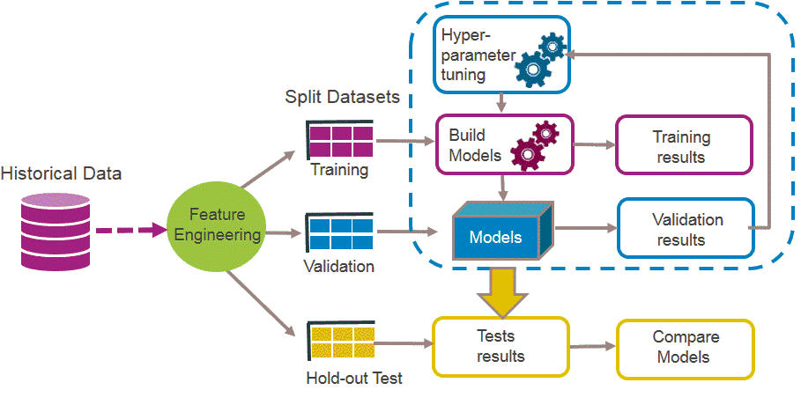

Slide 31
Production usage
Data aquisition
Data cleaning
Feature engineering
Building model (coding)
Training
model
Model evaluation
Production usage

Slide 32











Running in production
Parameters
HTTP API
Model hosting
Web application
Train model
Train dataset
Input data
Feature
engineering
Test dataset
Web application (embedded model)
Model
Test results
Model storage
Notes:
Containers
Scalability
Versioning

Slide 33
Types of algorithms

Slide 34
ALgorithms
Machine Learning
Unsupervised
Supervised
Reinforcement
Learn without examples (based on data)
Learn based on examples
Learn by punishment

Slide 35
Classification

Slide 36


Slide 37
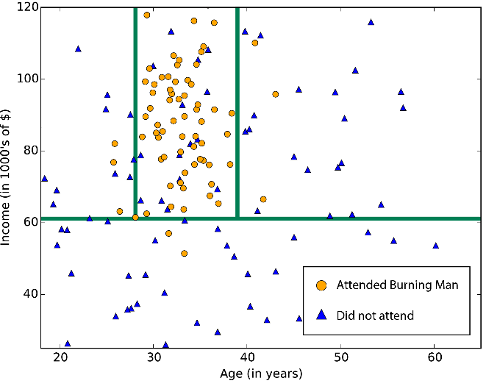
Classification – returns a Class
City | Income | Spouse | Children | Loan value | Decision
John | $95k | Yes | 2 | $250 | Yes
Peter | $140k | No | 0 | $210k | Yes
Sam | $32k | Yes | 1 | $20k | No
Anna | $110k | No | 1 | $750k | YES
.. | .. | .. | .. | .. | ..
City | Income | Spouse | Children | Loan value | Decision
Kate | $150k | Yes | 1 | $650 | ?
Notes:
https://docs.microsoft.com/en-us/azure/machine-learning/studio/algorithm-choice

Slide 38
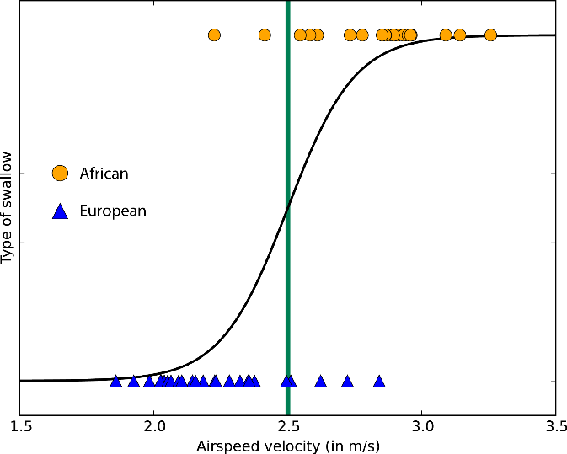
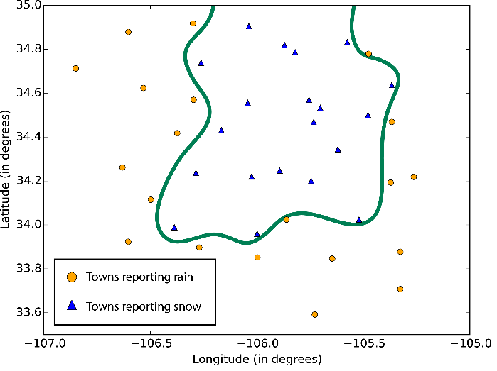
Classification
Decision trees Random forest
Linear classifier
Logistic classifier
Neural networks
Notes:
https://docs.microsoft.com/en-us/azure/machine-learning/studio/algorithm-choice

Slide 40
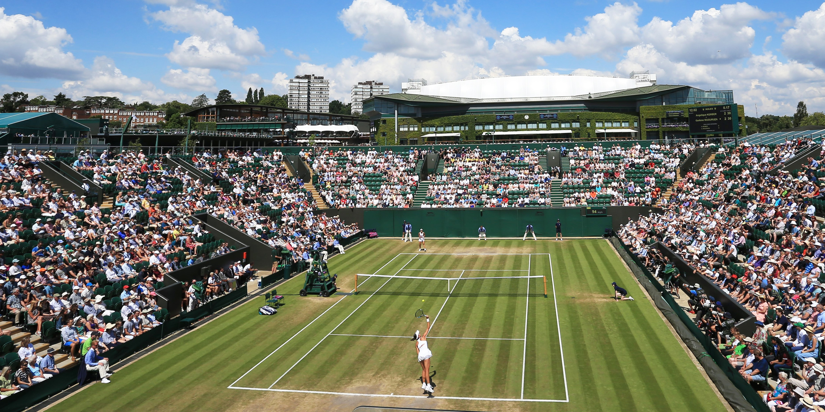

Slide 41
Regression
Notes:
https://docs.microsoft.com/en-us/azure/machine-learning/studio/algorithm-choice

Slide 43
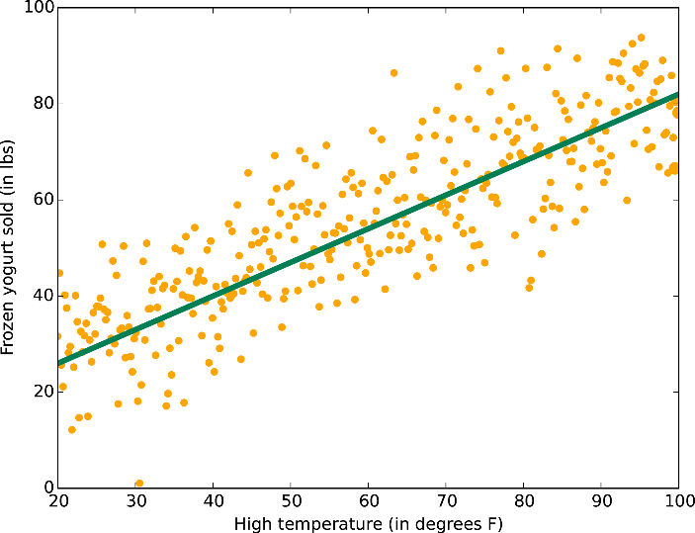
Regression – returns a number
City | Street | Value ($)
New York | N Heldon Ave 213 | 315
New York | Mountain Ave 153 | 412
River dale | Sunset Rd 13 | 128
Boonton | Vali Rd 12 | 178
… | ..
City | Street | Value ($)
New York | Belvedere Ave 153 | ?
Notes:
https://docs.microsoft.com/en-us/azure/machine-learning/studio/algorithm-choice

Slide 45
Clustering
Notes:
https://docs.microsoft.com/en-us/azure/machine-learning/studio/algorithm-choice

Slide 47
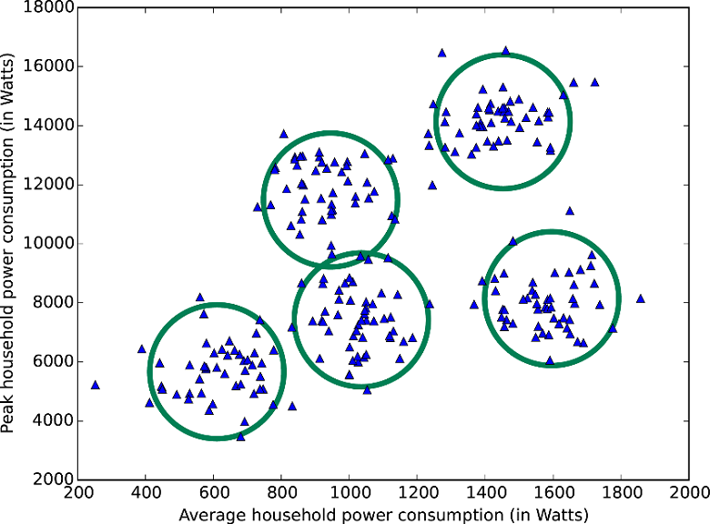
Clustering – find patterns

Slide 48
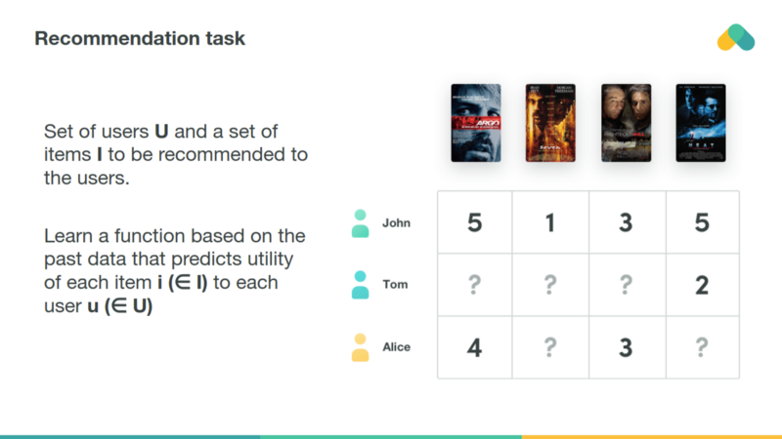
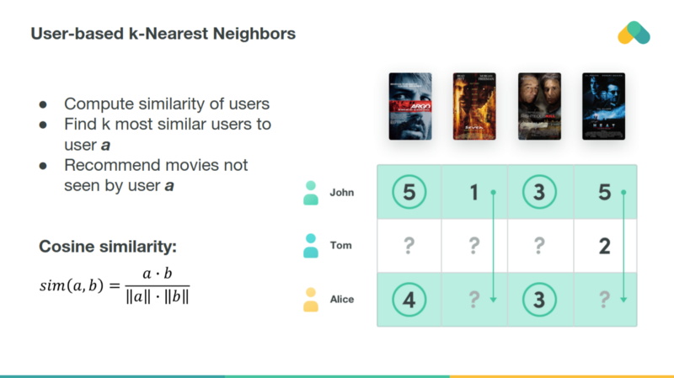

Slide 50
Dimensionality reduction
Notes:
https://docs.microsoft.com/en-us/azure/machine-learning/studio/algorithm-choice

Slide 52
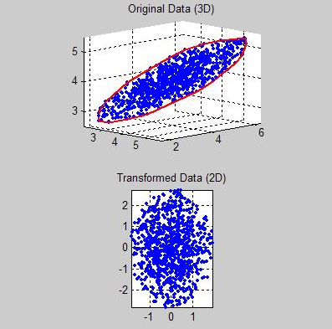
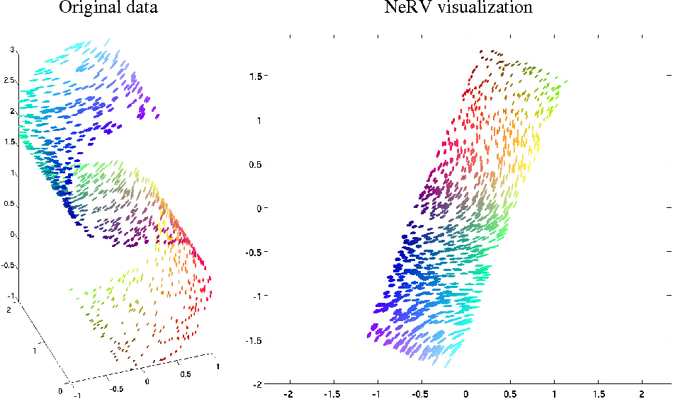
Dimensionality reduction

Slide 53
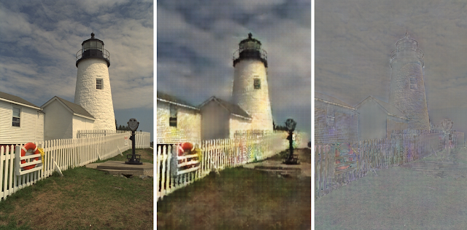
Meaningful compression

Slide 55
Reinforcement learning
Notes:
https://docs.microsoft.com/en-us/azure/machine-learning/studio/algorithm-choice

Slide 57


Slide 58


Slide 59
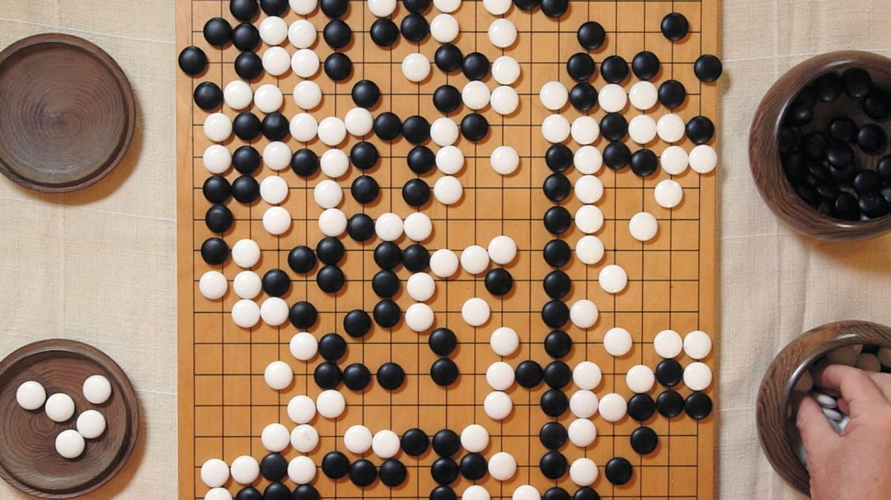

Slide 61
Neural network / deep learning

Slide 62

Neural network
Income
Children
0...1
Other loans

Slide 63
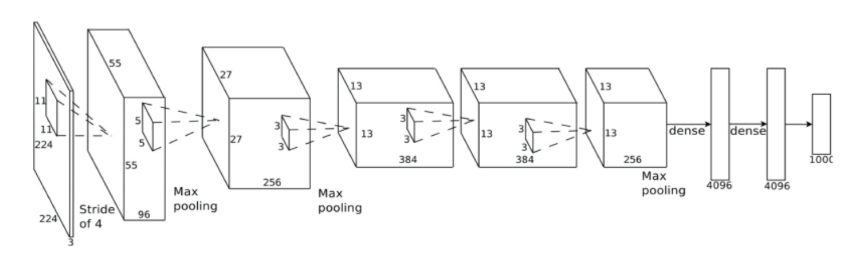
Deep Neural Network

Slide 64
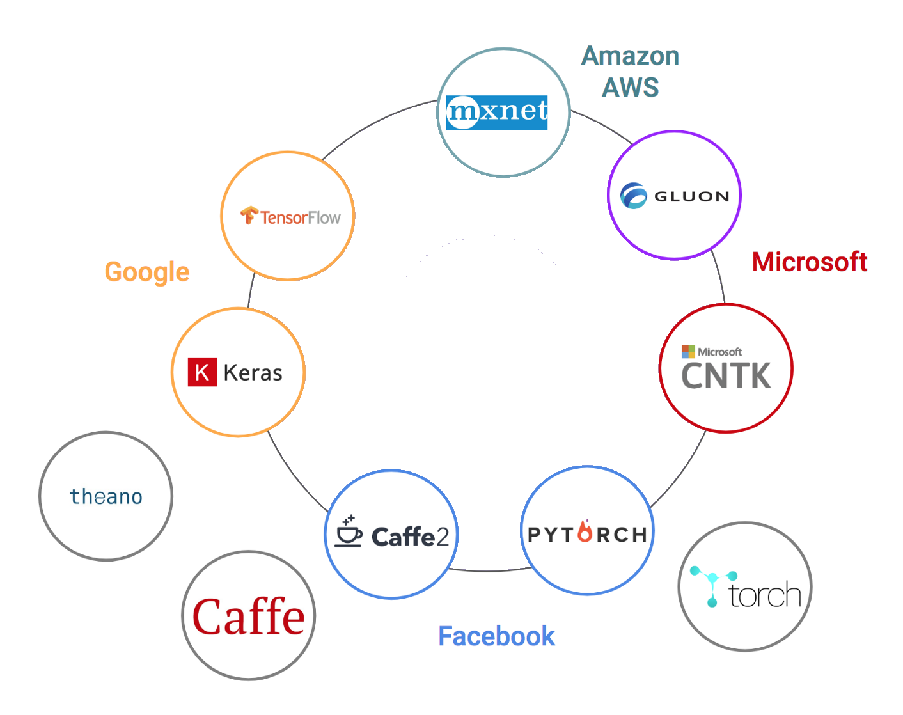
Deep Learning frameworks
Notes:
https://www.netguru.co/blog/deep-learning-frameworks-comparison

Slide 65
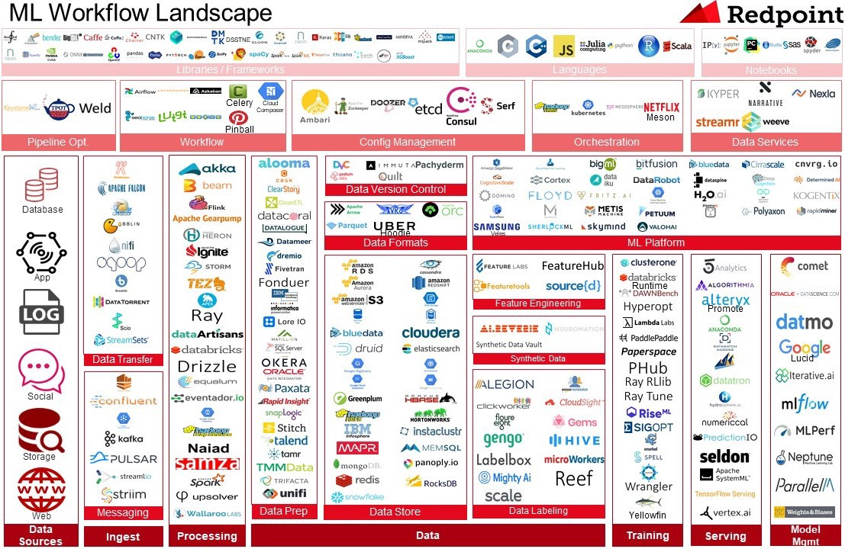
Notes:
https://medium.com/memory-leak/introducing-redpoints-ml-workflow-landscape-312ca3c91b2f

Slide 66
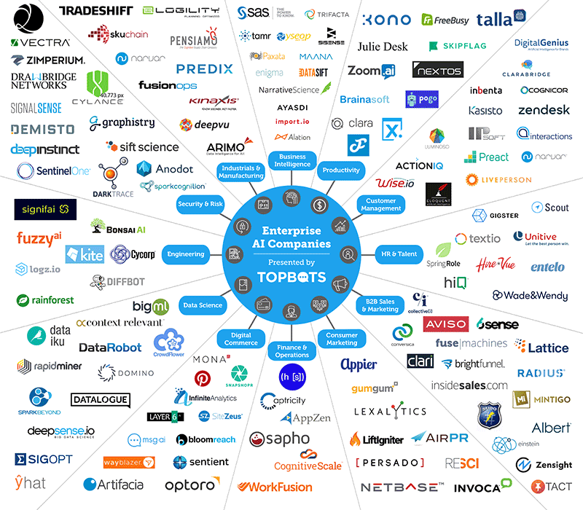
Notes:
https://www.import.io/post/the-essential-landscape-of-enterprises-artificial-intelligence-companies/

Slide 67
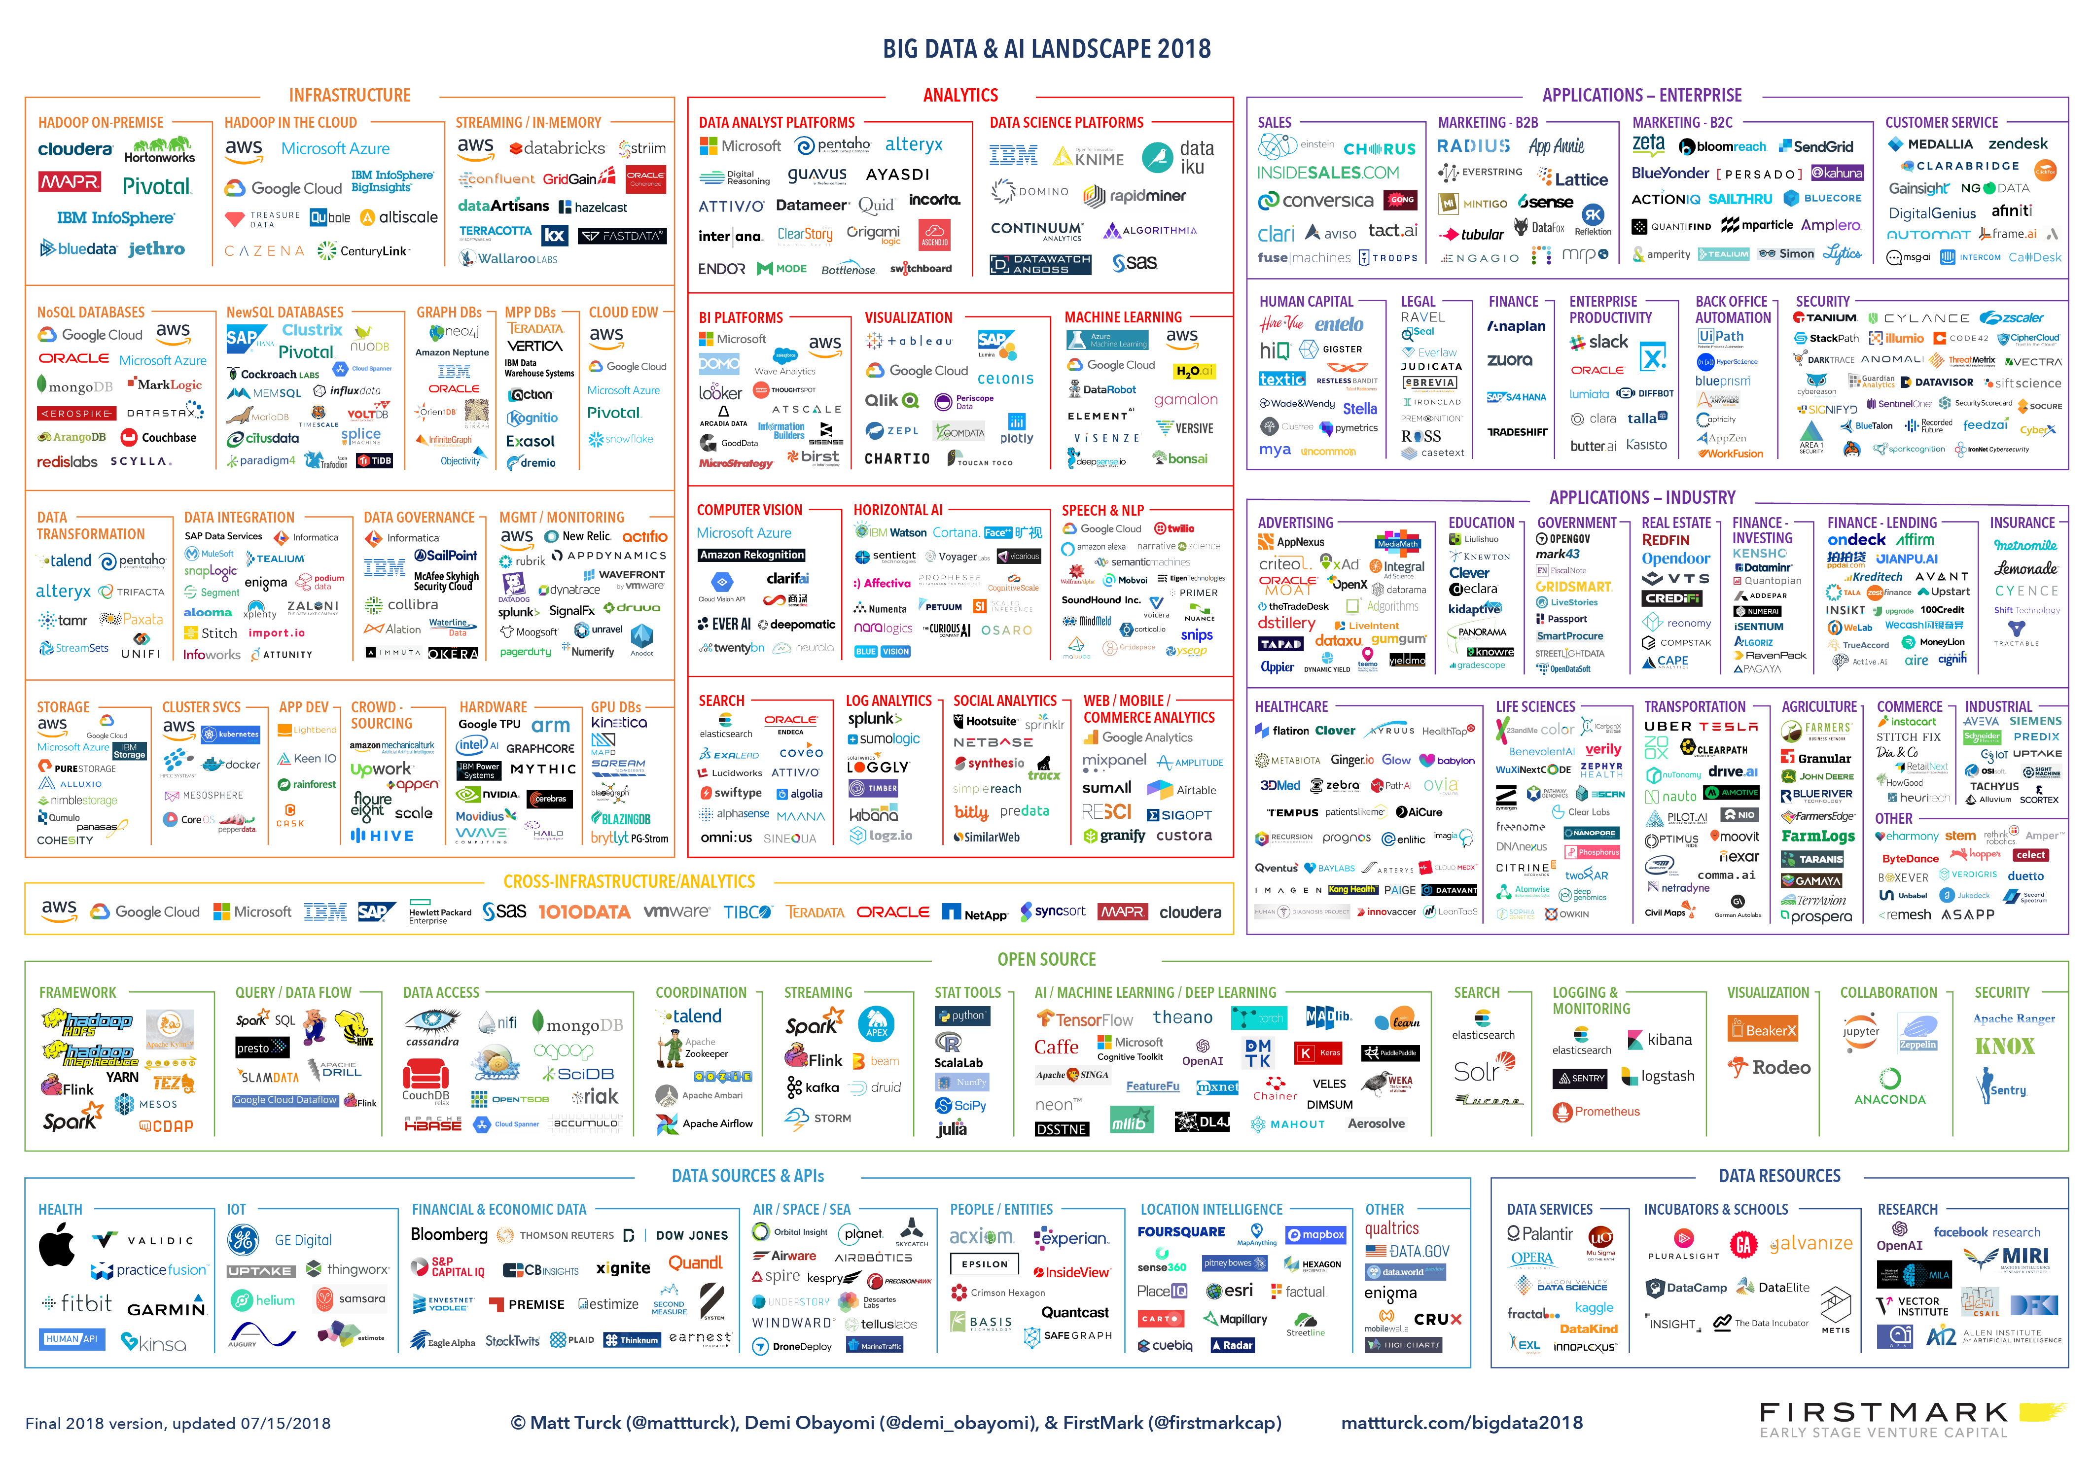

Slide 68
Advanced topics

Slide 69
Bias & amplification
Algorithms are not neutral

Slide 70


Slide 71
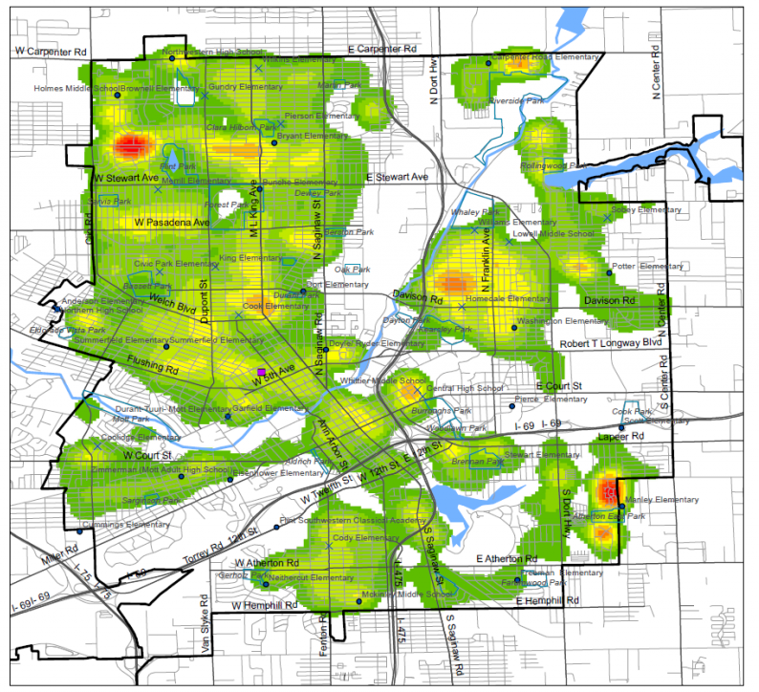
Notes:
Drug dealing

Slide 72
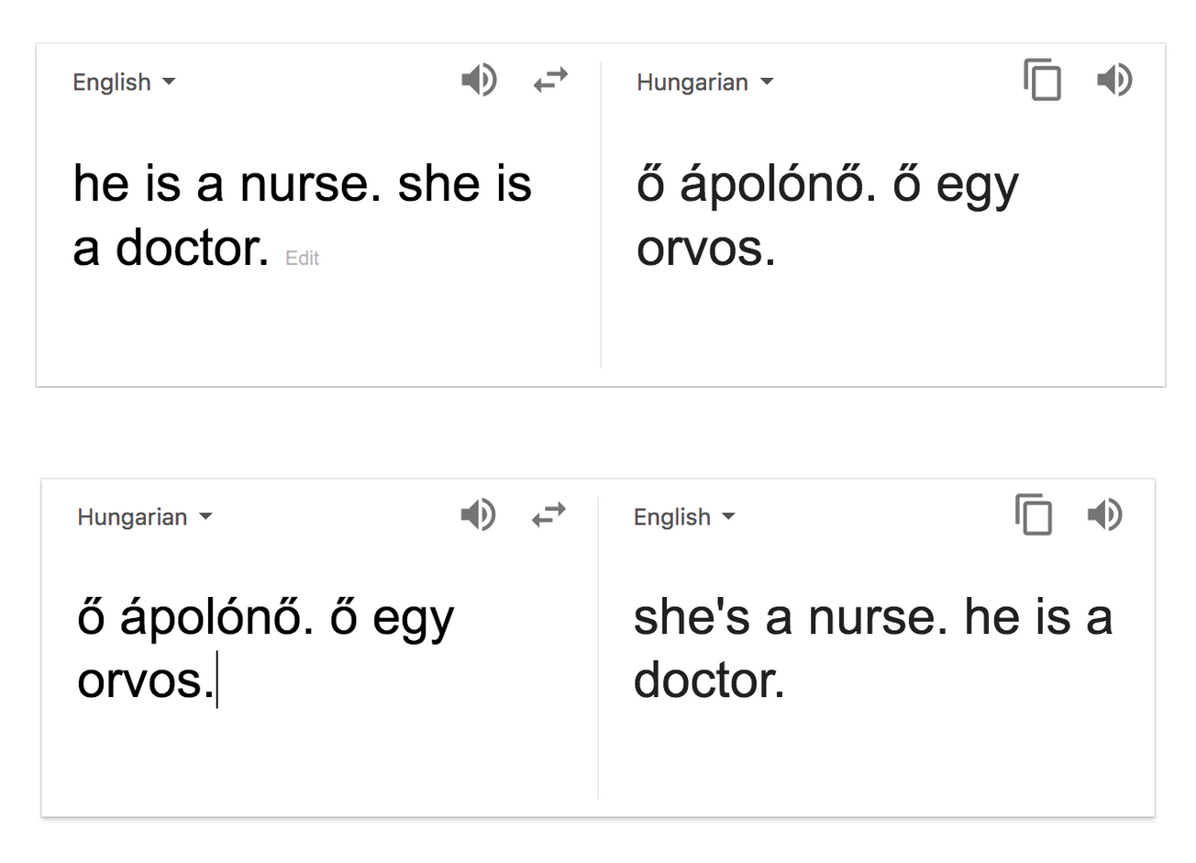

Slide 73

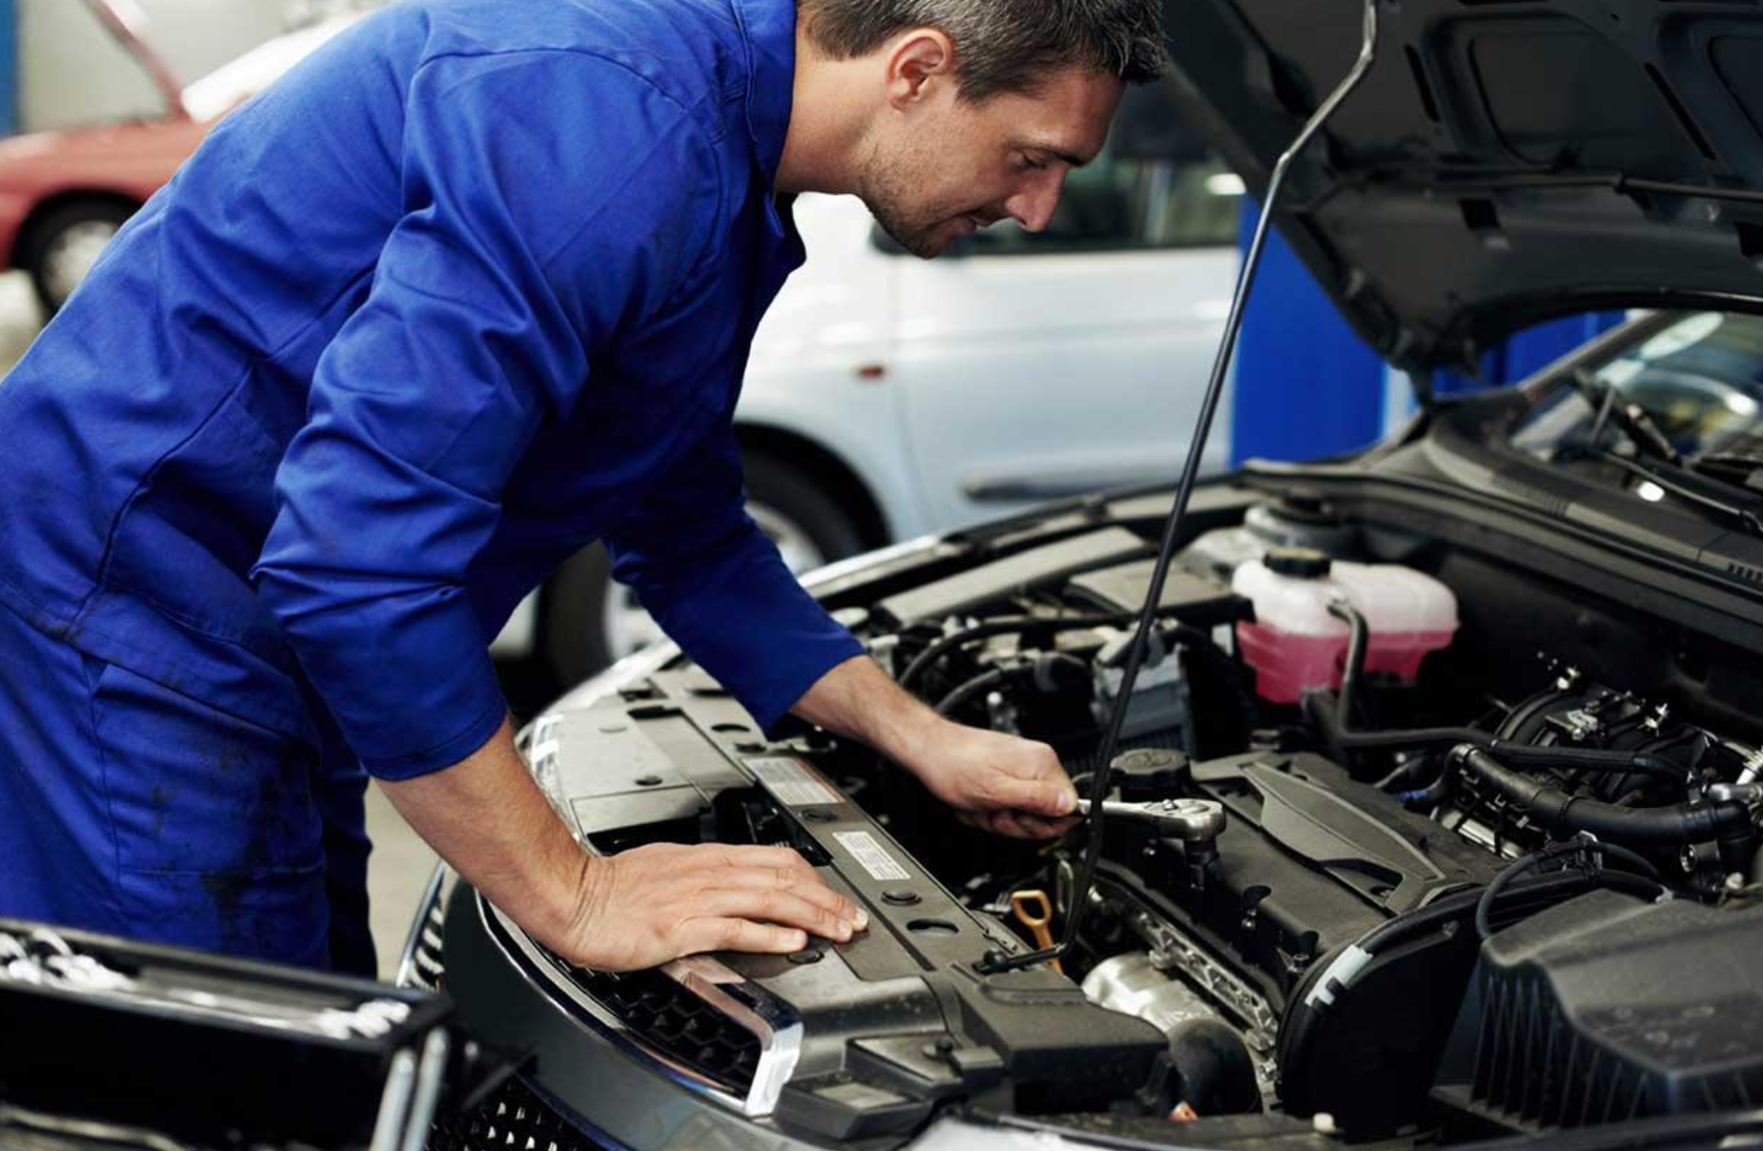

Slide 74


Slide 75
Can bias and prejudice be completely eliminated?
For both algorithmic and human methods, the answer is “probably not.”
We should focus on reducing amplification and having unbiased input data (not necessarily „neutral data”)

Slide 76
Traceability

Slide 77
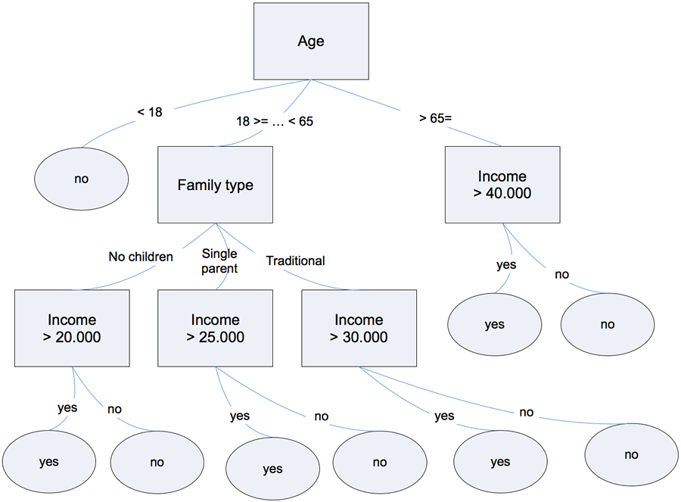
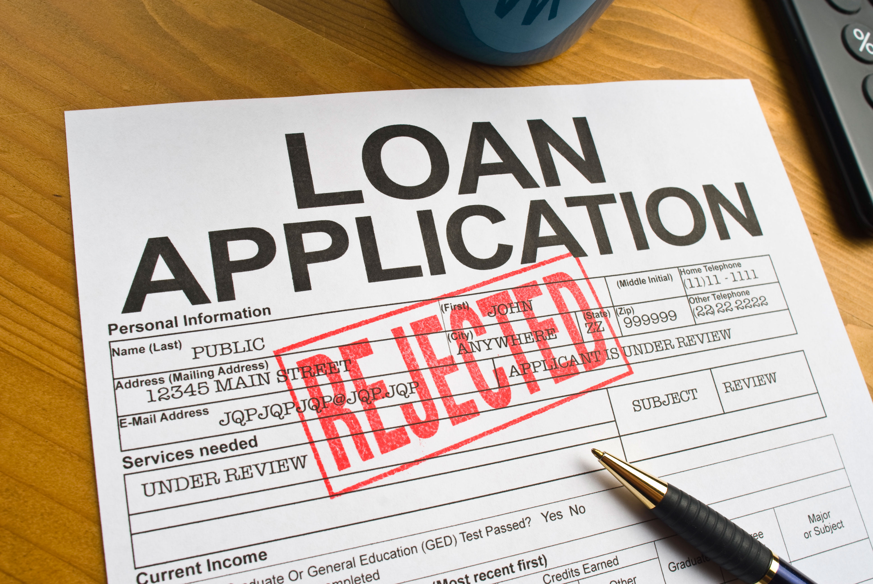
Traceability

Slide 78
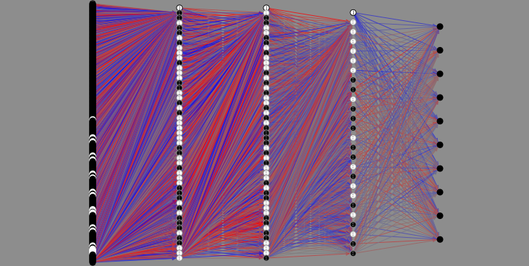
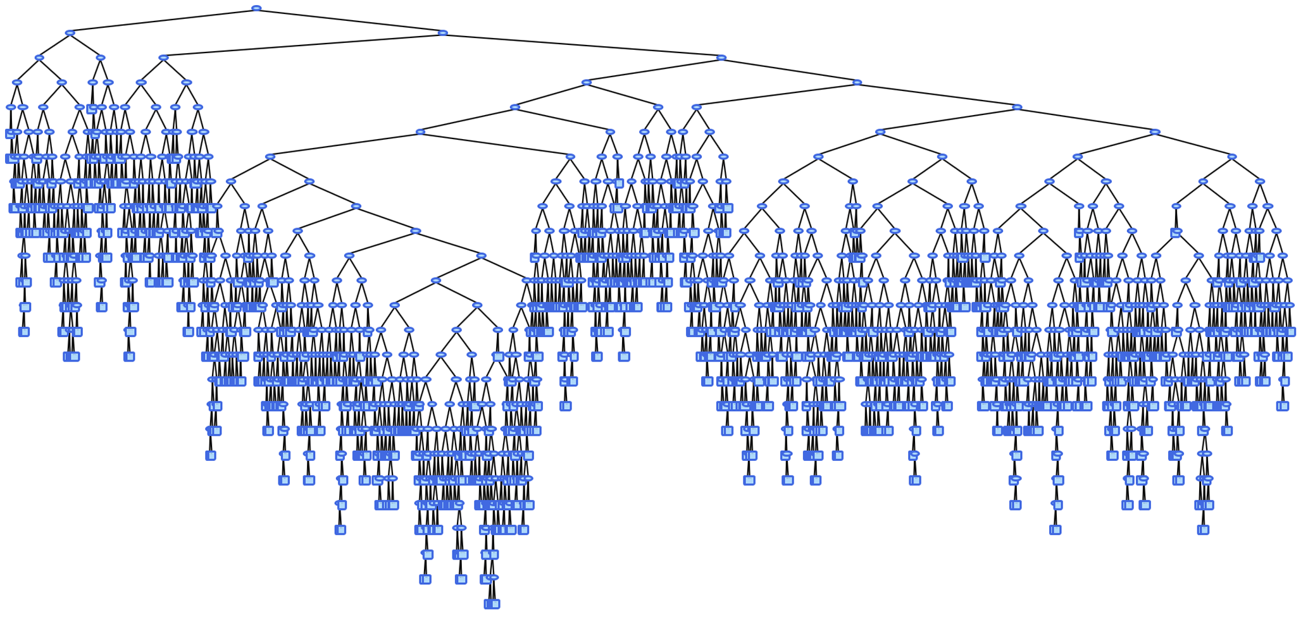

Slide 79
„Vulnerabilities”

Slide 80

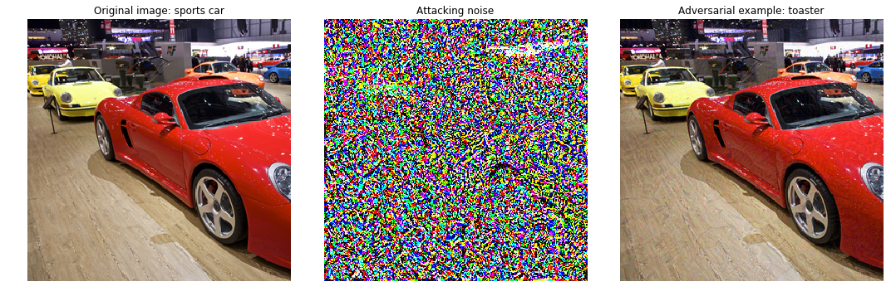
Adversarial attack

Slide 81
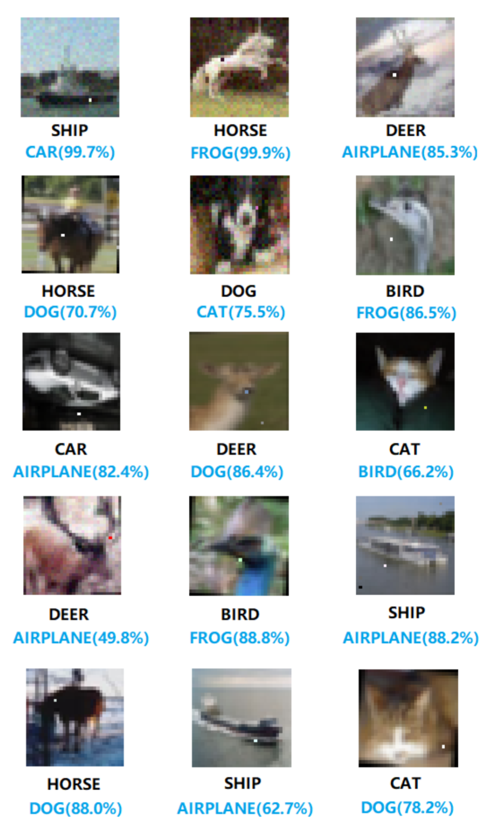
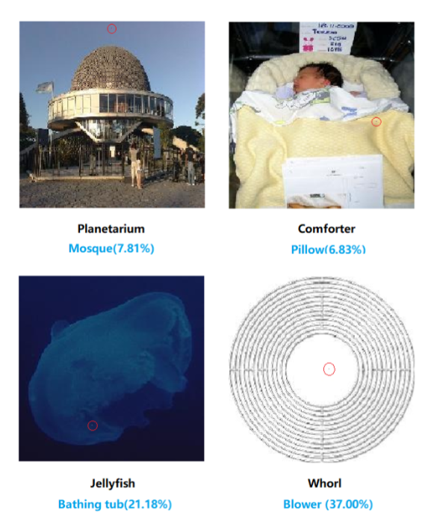
One pixel attack
Notes:
https://arxiv.org/pdf/1710.08864.pdf

Slide 82
Online training

Slide 83
Online training
Parameters
HTTP API
Model hosting
Web application
Train model
Train dataset
Input data
Feature
engineering
Test dataset
Web application (embedded model)
Model
Test results
Model storage
Notes:
Queues
Pre trained models

Slide 84
Summary

Slide 85
Democratization of ML
Easier data access
Highly scalable computing platforms
Open-source deep-learning frameworks
Developer friendly tools
Pre-built models
AI components
AI as SaaS
“AI chaining”

Slide 86
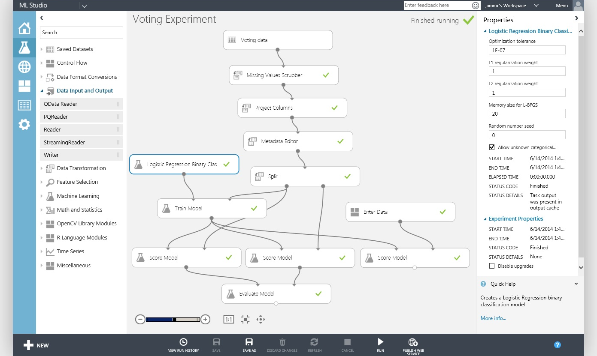

Slide 87
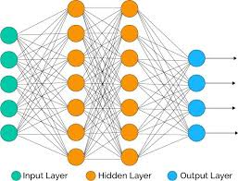




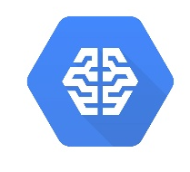
Raw deep learning
Easy of use
Pre-trained models
Classic raw algorithms
Saas AI
Algorihtms
Statistics
Classic ML
Complex ML
Problem complexity

Slide 88
Raw deep learning
Easy of use
Pre-trained models
Classic raw algorithms
Saas AI
Algorihtms
Statistics
Classic ML
Complex ML
Problem complexity

Slide 89
Recap

Slide 90
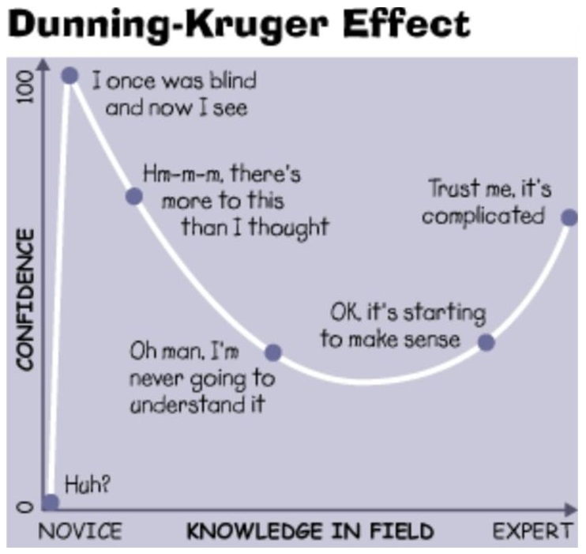

Slide 91


